Slide 1
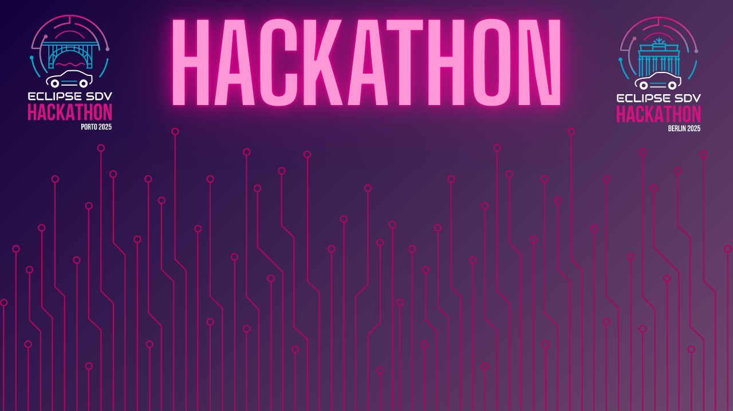

Chapter III - 2025
COPYRIGHT (C) 2025, ECLIPSE FOUNDATION

Slide 2
PITCHING SESSION RT-RK
COPYRIGHT (C) 2025, ECLIPSE FOUNDATION

Slide 3

The Plan
The project idea:
We wanted to create a proof of concept ADAS system that truly only assists the driver without taking control away
The plan:
Split up into groups, begin developing features and set up network/simulator/etc in parallel

Slide 4
Team and Structure
Sachin – Embedded systems lead
Vuk – System architecture
Blagoje – Algorithms development
Luka – Computer vision
Petar – Dashboard development

Slide 5
The Product / Service
Our SDV Platform reinforces driving with safety and intelligence at its core
Through modular ADAS features: lane keeping, emergency braking, pedestrian protection and recording on accident, orchestrated and validated in simulations, it enables a more informed and relaxed driving experience
Built to be scalable and expandable for future use and development

Slide 6
The Added Value
This solution beats others because it only enhances the driving experience without trying to remove the driver from the equation completely
Our SDV Platform delivers increased safety and driver confidence through advanced ADAS features tested in CARLA simulations
With a modular container-based design, and low latency communication, it ensures real-time reliability and future-proof scalability. The result is a smarter, safer driving experience that drivers can trust, and manufacturers can easily integrate and continuously innovate upon

Slide 7
The Added Value
Additionally, our solutions like RONA (Recording ON Accident) can provide crucial information to emergency services before arriving on site
The solutions are easily scalable and we’ve left room for further improvement, such as automatic emergency braking, automatic calling of emergency services, etc.

Slide 8
The Market & The Competition
The global ADAS and SDV market is projected to exceed $100B+ by 2030, driven by rising demand for safer, smarter, and connected mobility
OEMs and Tier-1 suppliers need solutions that are modular, scalable, and validated, enabling faster deployment and reduced development costs

Slide 9
The Market & The Competition
Our competitors tend to have common issues (hardware dependency, proprietary, closed source and platform specific solutions)
Along with that, a lot of modern ADAS features can feel intrusive and restrictive
We want to eliminate these issues by creating open-source, standardized ADA systems built to serve the driver

Slide 10
Business Model * Plan & Funds
Target automotive OEMs, Tier-1 suppliers, research labs, and smart mobility startups interested in a modular SDV/ADAS platform.
Showcase the platform at hackathons, automotive events, and tech demonstrations to attract partners and early adopters.

Slide 11
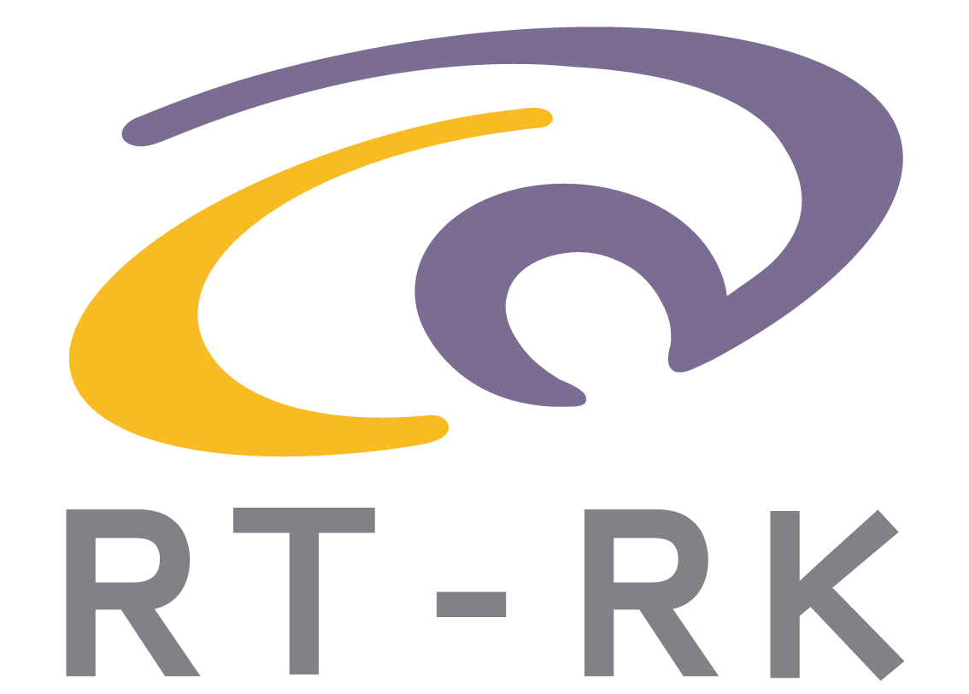
Contact
If you wish to collaborate with us, feel free to contact us at
info@rt-rk.com

Slide 12
Thank You
COPYRIGHT (C) 2025, ECLIPSE FOUNDATION

